Slide 1
NE 763: Advanced Reactor Materials
Fall 2025
Dr. Benjamin Beeler

Slide 2
Last Time
Metallic fuel performance modeling
needs to fully encompass mechanical behavior, chemical interactions, fission gas behavior, and temperature profile
Porosity models inform temperature profiles which inform redistribution/phases (cycle)
Validate against limited data: cladding strain, gas release, cladding T
Metal fuel fabrication/reprocessing
historically via injection casting
pyroprocessing with molten salts, depositing U/MA/TRU on cathodes
can refabricate via injection casting for closure of fuel cycle

Slide 3
Last Time
MOX fuels
higher powers and higher temperatures
similar geometry to metallic fuels, but with shorter plenum, higher smear density, pellet fuel
MOX restructuring
high T and steep T gradient lead to four distinct zones in MOX fuel
central void, columnar grains, large equiaxed grains, as-fab microstructure
void+columnar grains result of pore migration up the T gradient

Slide 4
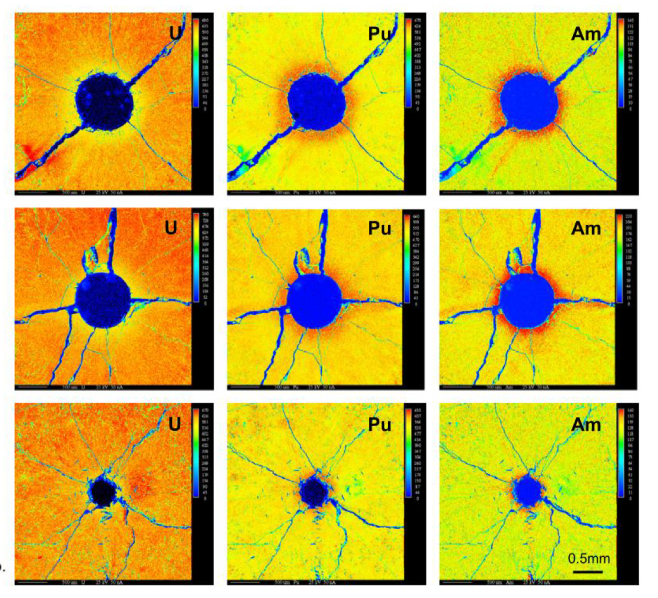
Redistribution of Pu
The movement of pores leads to a redistribution of plutonium, resulting in a spike in Pu concentration surrounding the central void
Similar behavior has been observed for americium
This transuranic concentration increase is accompanied with a decrease in U concentration
This redistribution increases the local fission rate and centerline temperature, while generating lower melting point phases

Slide 5
Redistribution of Pu
This phenomenon is currently understood as an evaporation-condensation process
The fuel at the edge of the pore closest to the centerline becomes gaseous inside the pore and deposits itself on the cooler region of the pore closest to the cladding
UO2 is the more volatile of the U/Pu heavy metal species present in the fuel matrix
The high oxygen potential can lead to a high partial pressure of UO3 within the self-contained pores
Enriched regions of PuO2 are left behind and deposited at the leading edge of the central void as the porosity accumulates in the fuel center
Some experiments on O/M ratio seems to point towards higher O potential leading to more redistribution
While this is the working theory, it is not clear if this explanation can also account for the necessary pore velocities
No experimentally proven substitution has been put forth as a replacement theory to the observed features

Slide 6
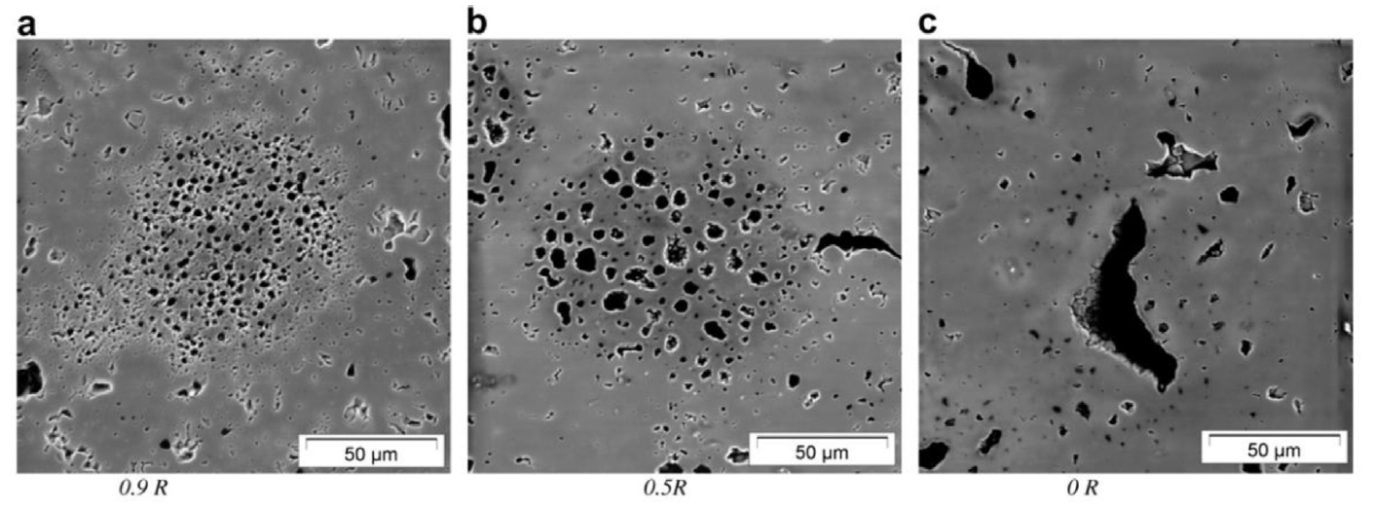
Pu-rich Agglomerates
Regions of high Pu concentration form in the MOX fuel matrix due to incomplete mixing during fabrication
Clusters of dispersed porosity form in high Pu concentration regions because of the high fission rate
Thermal conductivity of the spots is also lower than the surrounding matrix, thus the PAs are both hotter and undergo a greater number of fission events in a very small region
Burnup in these regions may be 2-3 times greater than that of the pellet as a whole
The morphology of porosity in the agglomerates depends on the temperature, with smaller bubbles in cold regions and large bubbles in hot regions
Porosity formed due to PAs are visually distinct from fission gas bubbles or pre-existing porosity

Slide 7
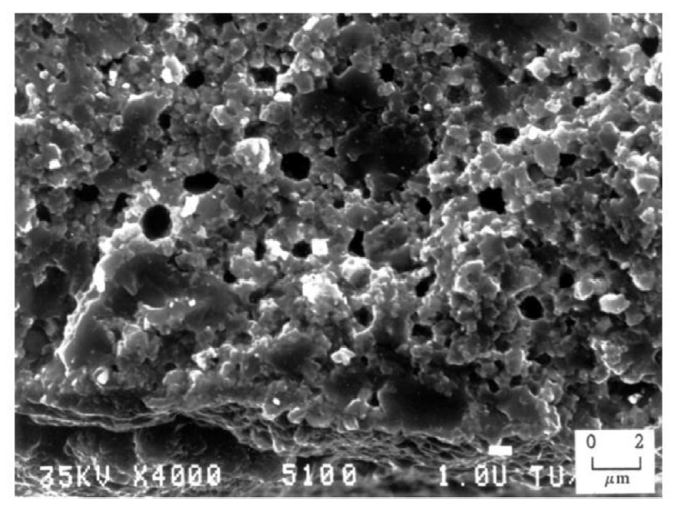
Pu-rich Agglomerates
The presence of the high burnup structure (HBS) has been observed within the PA regions
The HBS is basically a fine grained, cauliflower-like structure
In MOX fuels, the HBS structure appears in fuels following burnups between 60 and 80 GWd/tM at temperatures below approximately 1100C
PA's reach these local burnups at pellet burnups far below this threshold

Slide 8
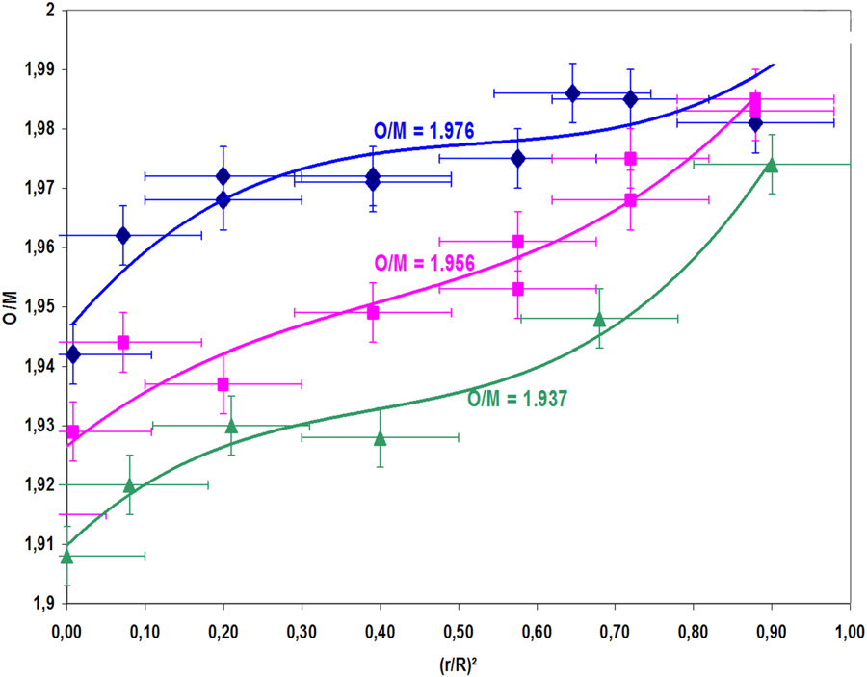
Oxygen Redistribution
The as-fabricated oxide pellets used as fuel in fast reactors are always hypostoichiometric with an initial O/M typically in the range 1.93–2.00
Oxygen is redistributed radially, migrating down the thermal gradient, thus bringing the composition close to stoichiometry near the periphery, whereas the O/M ratio becomes very low in the hottest area
Oxygen transport is likely a combination of vapor and solid diffusion

Slide 9
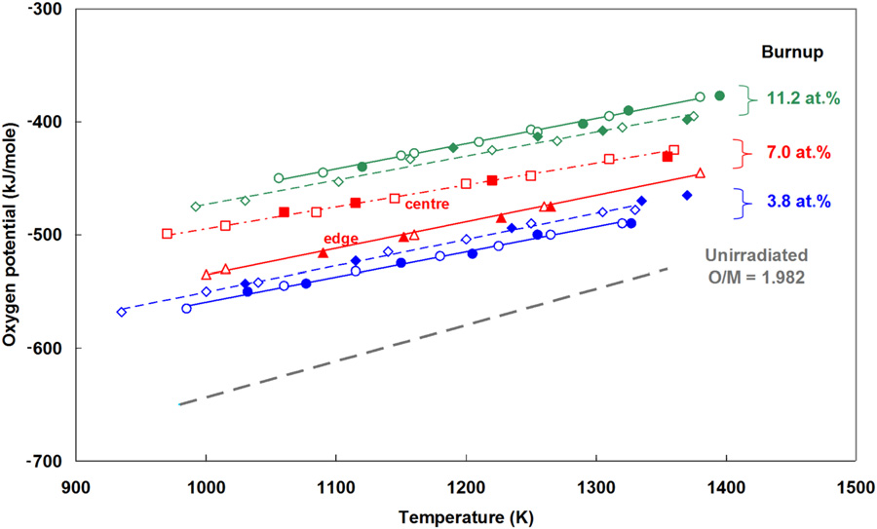
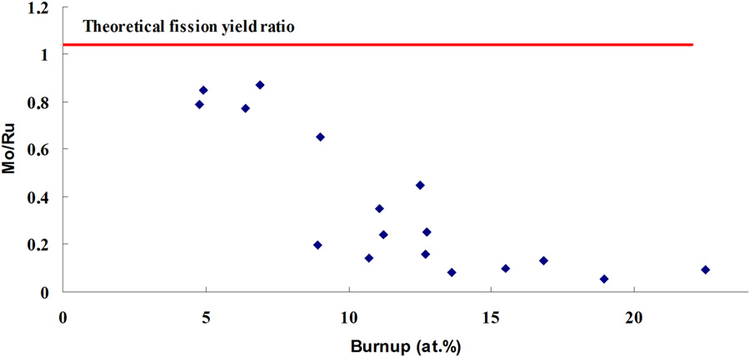
O/M Ratio
Fission releases two oxygen atoms, which cannot be fully bound by the fission products, this increases the O potential in the fuel as dissolved O
The O potential increases until the point where Mo starts to oxidize, leaving the metallic inclusions
The O/M ratio increases until Mo starts to oxidize, then maintains at approximately 2.0 or thereabouts
Oxygen potential vs T at different burnups
Ratio of Mo/Ru in metal precipitates

Slide 10
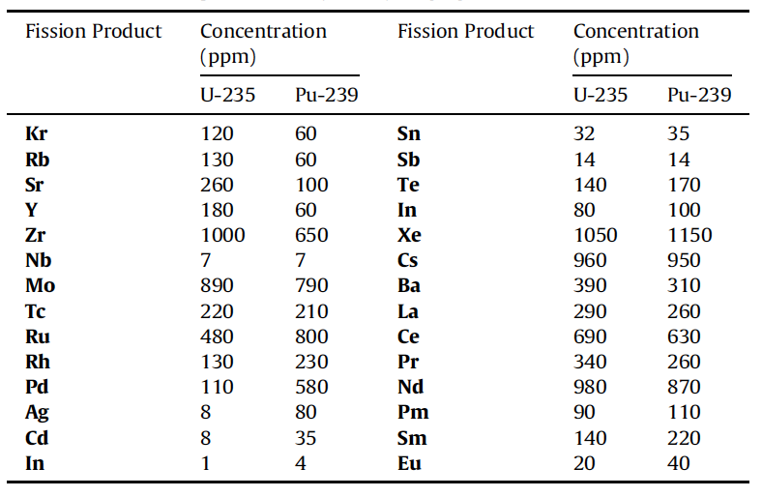
Solid Fission Products
Fission products in oxide fuels can be grouped into 4/5 categories
Fission gases and volatile species
Metallic precipitates
Oxide precipitates
Soluble oxides
LWR fuel vs Pu-containing MOX fuel, we see a higher concentration Ru, Rh, Pd, and a lower concentration of Zr and Mo
Target higher burnups, so we have a very high inventory of fission products

Slide 11
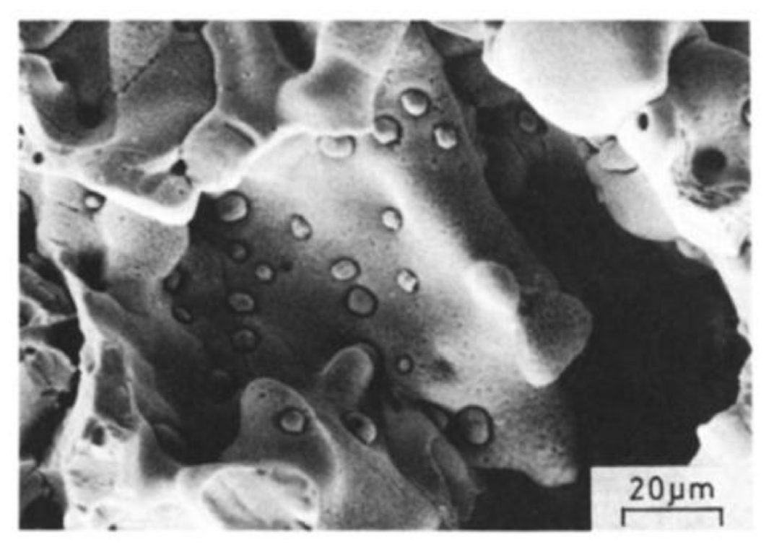
Metallic Inclusions
Mo, Tc, Ru, Rh, and Pd form prominent phases in irradiated nuclear fuels commonly referred to as “white inclusions,” “noble metal,” or “five-metal” precipitates
The particles exist as a solid solution taking on the hexagonal close packed (hcp) structure
The particle size, frequency, and composition exist over a wide range, depending on the burnup and position found within the pellet

Slide 12
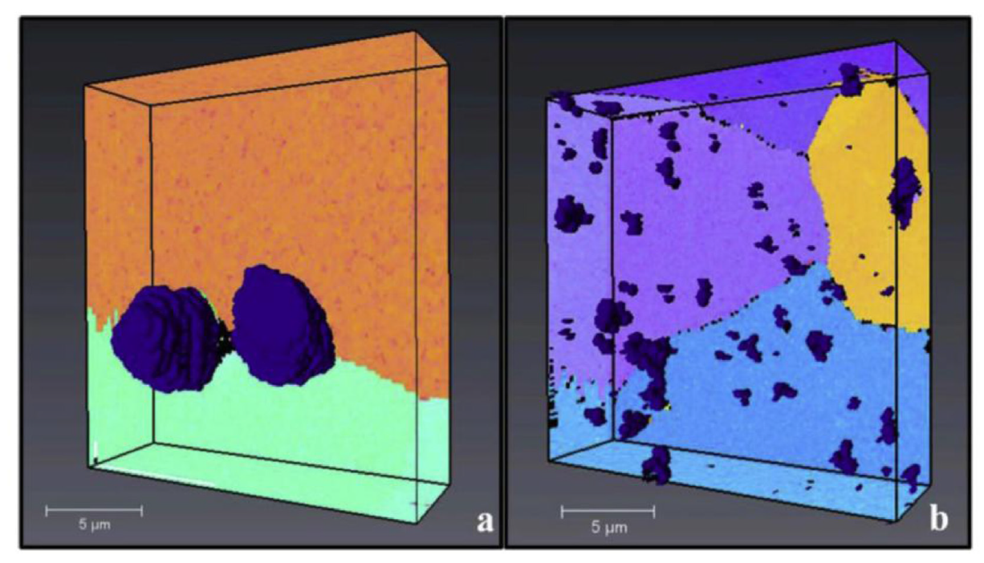
Metallic Inclusions
In the columnar grain region of the fuel, the particles are commonly 5-10 μm in diameter, collecting primarily on the grain boundaries
Particles tend to be much smaller (2 μm and below) in the equiaxed and as-sintered regions, but occur more frequently intragranularly
The particles form as a result of fission product phase agglomeration, as opposed to nucleation and growth process
Columnar Grain Region
Equiaxed Grain Region

Slide 13
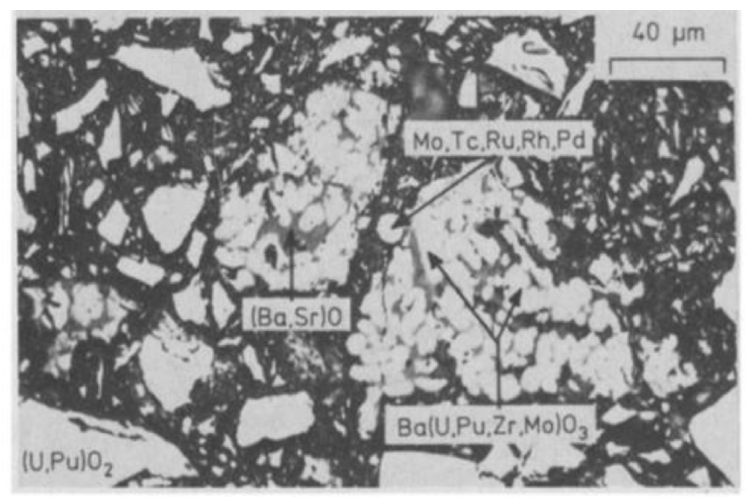
Oxide Phases
Oxides containing Sr, Zr, or the rare earth (RE) elements form solid solutions with either UO2, PuO2, or both at low concentrations
Barium is only soluble to 1.6 at% in MOX fuels and thus precipitates a separate oxide phase at higher concentrations
The separate oxide phase, commonly referred to as the “grey phase,” form ABO3 perovskite structures, in which A=(Ba1-x-y, Srx, Csy, x,y ≪1) and B=(U, Pu, Zr, Mo, RE)
The particles are primarily Ba rich, followed by Zr, U, Pu, Mo, Sr, and trace amounts of the remaining products
Due to the sheer number of constituents, the structures are largely unknown
Grey phase is typically found in the equiaxed or outermost regions of the columnar grains commonly intermixed with other constituent oxides

Slide 14
Joint Oxyde Gaine
The volatiles class of fission products produced during reactor operation are of particular interest to fuel-cladding interactions
Cs, Te, and I all evaporate at low operating temperatures and migrate to the coolest part of the fuel where they react with fuel or cladding constituents
Mo has a tendency to combine with Cs and O to become volatile and migrate toward cooler fuel regions
This has been termed Joint Oxyde Gaine (JOG)
JOG is an oxide buildup formed on the fuel surface between the pellet and cladding
After gap closure, there remains a minimal residual gap
Primarily Cs2MoO4 or Cs2(U, Pu)O4, the JOG structure is irregular and dense, found in regions where the peak fuel temperature is lowest

Slide 15
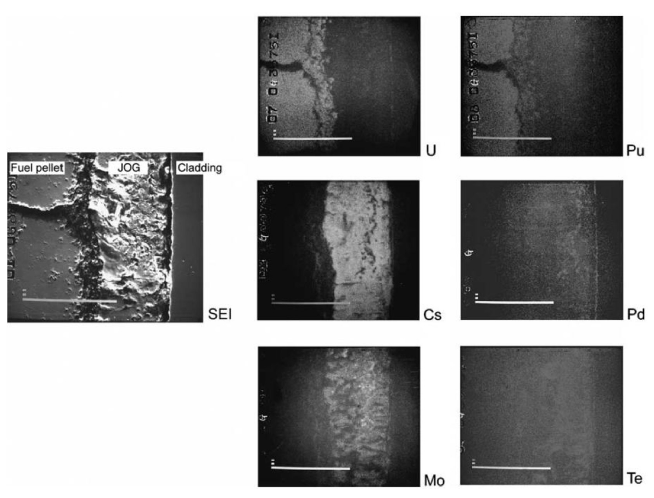
Joint Oxide Gain
The volatile constituents of the JOG structure evaporate from the fuel pellet at high temperatures and condense to become solid at the cooler top or bottom of the fuel
It is believed that the existence of JOG aids in thermal transport of the fuel, as the oxide structures have higher thermal conductivity than a fuel-cladding gap filled with fission gases

Slide 16
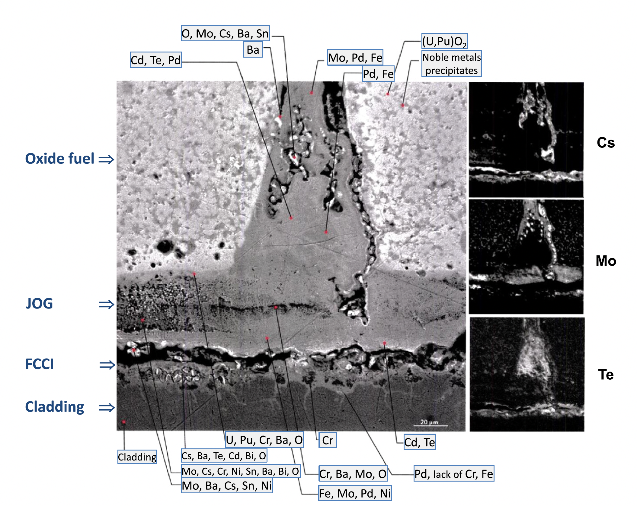
Joint Oxide Gain
JOG acts as a mechanical buffer, limiting the amount of PCMI, or stresses in the cladding
JOG reduces fuel swelling, by allowing fission products to leave the fuel into a preferable chemical state
Fission products in the JOG play a predominant role on FCCI and on the resulting strong cladding corrosion

Slide 17
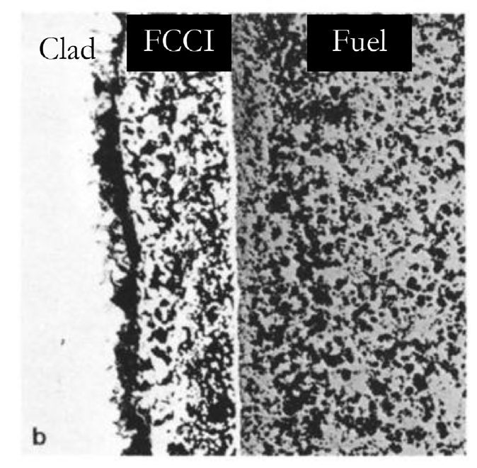
MOX FCCI
While T is too low in LWRs with MOX to initiate FCCI, in SFRs with MOX, the cladding inner surface temperature can reach sufficiently high temperatures under normal operating conditions to initiate detrimental oxidation and chemical attack
FCCI manifests itself in three primary modes: matrix attack, intergranular attack, or combined, which demonstrates the properties of both matrix and intergranular attack
Matrix FCCI attack corresponds to the localized oxidation of the cladding material, with primarily oxidation of the Cr in the stainless steel

Slide 18
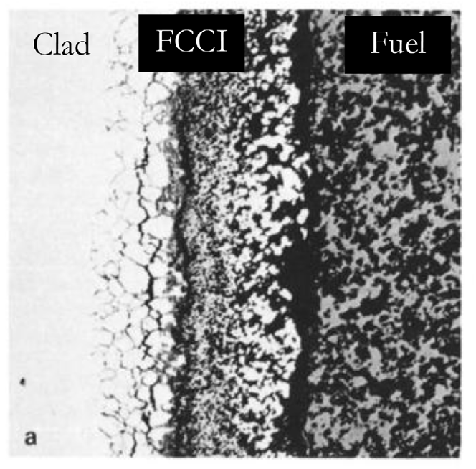
MOX FCCI
Intergranular attack modes occur due to the depletion of Cr in grain boundaries due to the formation of Cr23C6 carbides allowing penetration of corrosive species
Oxygen and volatile fission products (Cs, Te, I, etc.) are the primary culprits of FCCI initiation in oxide fuel systems
In MOX fuels, the oxygen potential of the system is the greatest difference from LWR UO2
The preferential formation of noble metals rather than oxide formers leads to an excess of available oxygen in the system

Slide 19
MOX FCCI
Under normal operation, stainless steel cladding forms a chromia (Cr2O3) layer that acts to protect the cladding from corrosion
Cs is generally unreactive with stainless steel claddings, but reacts with the protective oxide layer to create Cs-chromates (Cs2CrO4 or Cs2Cr2O7) when excess oxygen is present
The decay of the protective oxide layer causes deeper penetration of the FCCI into the cladding
Iodine is primarily bound to Cs in the form of CsI, and can lead to an enhancement in oxidation in hyperstoichiometric fuels
Tellurium is highly active when combined with Cs to create Cs2Te, which can dissolve cladding constituents in the presence of high oxygen potential
The O/M ratio of the fuel before and during irradiation are significant factors, and FCCI can potentially be limited by operating with a hypostoichiometric initial fuel composition

Slide 20
MOX Summary
Phenomena of interest: Restructuring, O and Pu redistribution, Pu agglomerates, fission product chemistries, JOG formation, and FCCI
O/M ratio is one of the most significant factors in determining the nature of actinide redistribution, fission product precipitate chemistries, and FCCI formation
The effects of fission product precipitates and Pu agglomerates on fuel thermal behavior is highly localized with little discernible influence on the overall fuel burnup behavior

Slide 21
Sodium coolant

Slide 22
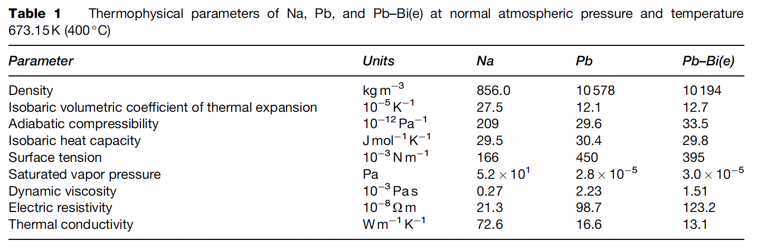
Liquid Metal Coolants
Liquid metals (LM), such as sodium (Na), lead (Pb), and lead–bismuth (Pb–Bi) eutectic, are considered as potential coolants for the fast spectrum nuclear reactors of the next generation
The main advantages of Na coolant in comparison with Pb are the lower melting temperature, density, and dynamic viscosity and the higher thermal and electrical conductivities

Slide 23
Sodium
Sodium is a solid at room temperature; melting point is 98 C; boiling point is 881 C
Therefore, sodium is in the liquid phase at FR operating temperatures without pressurization
For this reason, it is not necessary to adopt the pressurized design employed in light water reactors for SFRs (SFRs operate near atmospheric pressure)
Sodium is a great heat transfer medium due to high thermal conductivity, high heat capacity, and large liquid range
Allows for high power density core and low coolant fraction
Na has insignificant neutron moderation, making it suitable for the coolant for the FBR
The weakness of sodium as a coolant is its reactivity with oxygen and/or water

Slide 24
Structural Material Selection for Na
It is necessary to take the environment into consideration by estimating the mechanical properties and thermal characteristics
Environments specific to the SFR components include: (a) contact with the coolant, (b) high temperature at which the creep effects must be taken into account, and (c) neutron irradiation
The dissolution of elements contained in the material, such as iron, chromium, and nickel, in sodium and the reverse phenomenon (deposition) occur on the material surface due to the difference in chemical potential
The behavior is fundamentally controlled by the solubility of the material elements in sodium and by the diffusion rate of the materials

Slide 25
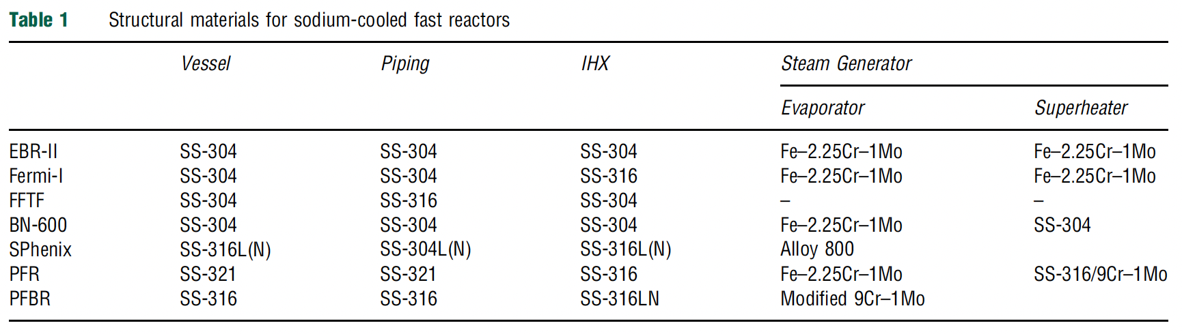
Structural Materials in SFRs
Austenitic and ferritic/martensitic steels are two key alloy classes for SFR structural materials
Most research has been done on SS-304 and SS-316, but advanced alloy behavior (HT9, T91, ODS steels, etc.) is being studied

Slide 26
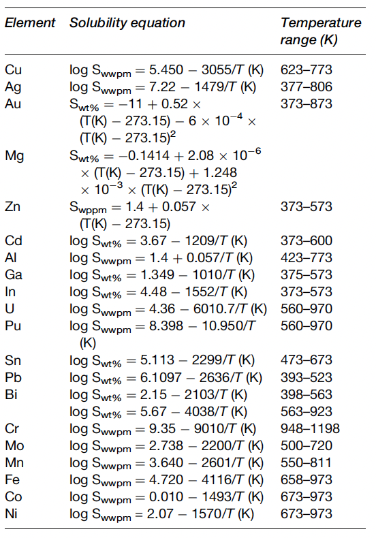
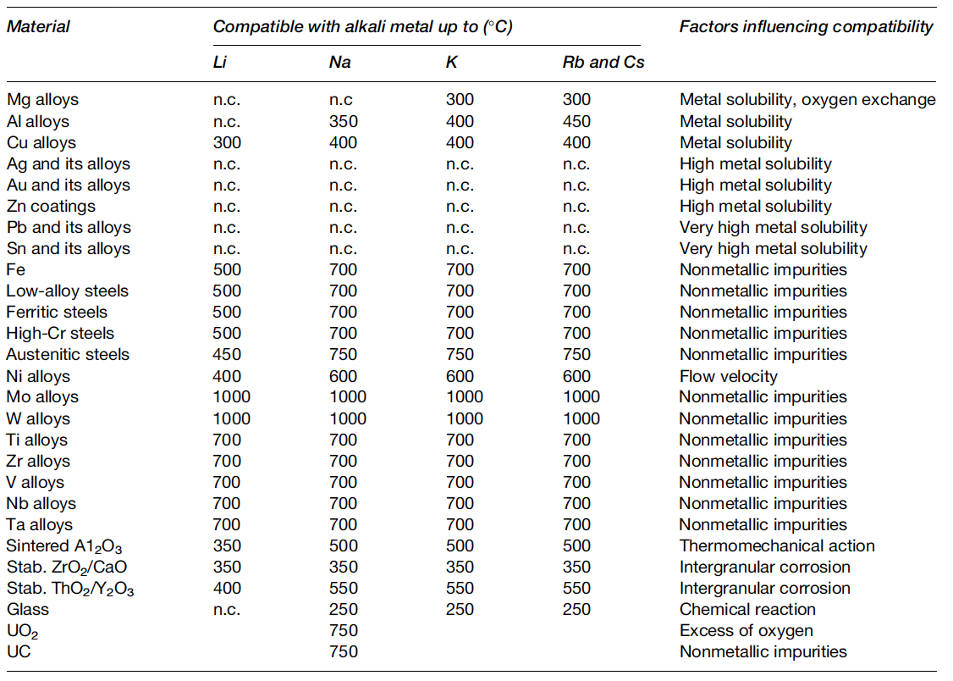
Solubilities and Compatibility
Among the elements in austenitic stainless steel, the solubility of nickel is greatest
Therefore, the phase transformation of austenite to ferrite through nickel dissolution is observed on the surface in long-term immersion in sodium

Slide 27
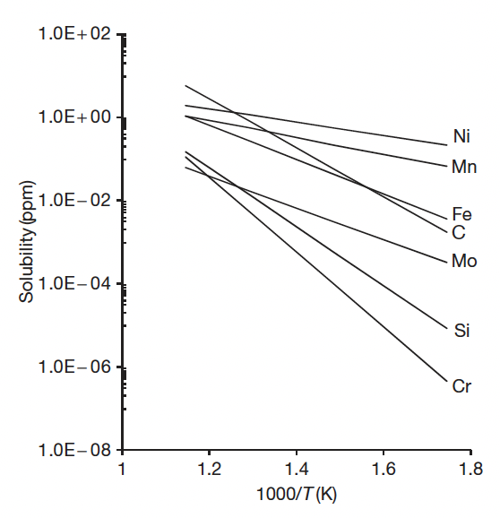
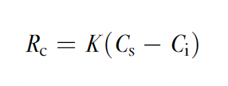
Sodium Corrosion
There are two known mechanisms of sodium corrosion
Type I: corrosion produced by the dissolution of alloy elements to sodium
Type II: corrosion produced through chemical reaction with the impurities in sodium
Type I corrosion is dependent on the solubility in sodium of the elemental composition in the material, temperature, and the rate of solution
K is the solution rate constant, Cs is the solubility limit in sodium, and Ci is the actual concentration in sodium

Slide 28
Sodium Corrosion
The solubility of each of the primary components of stainless steel in sodium at 550 C is less than a few parts per million
This means that the nominal compatibility of the steels with sodium is excellent
In the isothermal sodium condition, the corrosion of the steels stops when the dissolved elements reach saturation concentration at the temperature of sodium
Under non-isothermal conditions, the corrosion behavior is called thermal gradient mass transfer
In the cooling system, the elements in the materials in the high-temperature section dissolve as a result of the temperature dependency of the solubility of the elements in sodium, and the dissolved elements are deposited on the steel surface in the low-temperature section by the same mechanism

Slide 29
Thermal gradient mass transfer
Coolant heated in the core; high solubility for elements in the coolant; elements leave structural materials, go into coolant
Heat removed from coolant via IHX; lower T means lower solubility; elements plate out on piping surfaces; coolant now has lower concentration of corrosion species

Slide 30
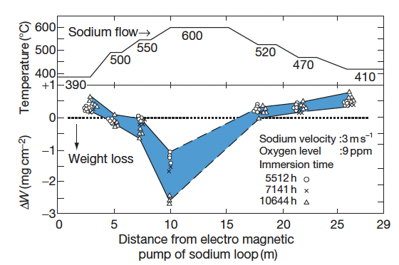
Sodium Corrosion
The results of thermal gradient mass transfer using a sodium loop made of 316SS
The weight loss caused by the dissolution of the elements in the steel is in the high-temperature section, and the weight gain caused by the deposit of the dissolved elements in sodium is observed in the low-temperature section

Slide 31
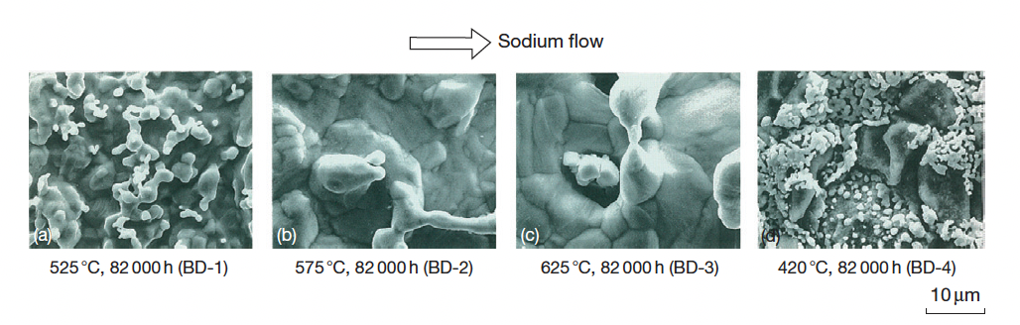
Sodium Corrosion
Dissolution of the elements in the material is observed in the high-temperature section, and precipitation is observed in the low-temperature section

Slide 32
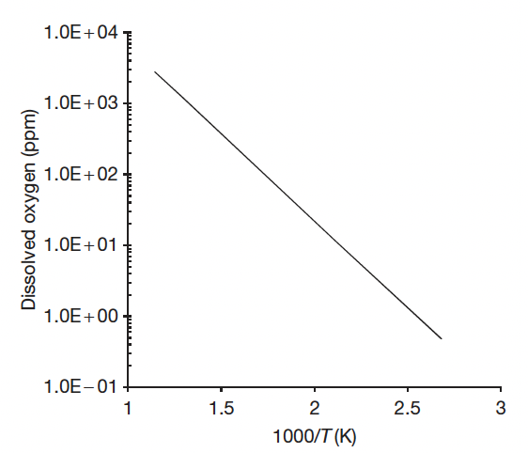
Impurity Sodium Corrosion
Type II-Corrosion Produced Through Chemical Reaction with the Impurities in Sodium
The control of impurities in sodium can be achieved by using techniques to deposit/collect the dissolved impurities in sodium
Impurities such as oxygen, carbon and nitrogen in sodium can have a strong effect on the corrosion rate of a material
Sodium is the reducing agent, and its affinity to oxygen is very strong
The solubility of oxygen in sodium is significantly higher than in water

Slide 33
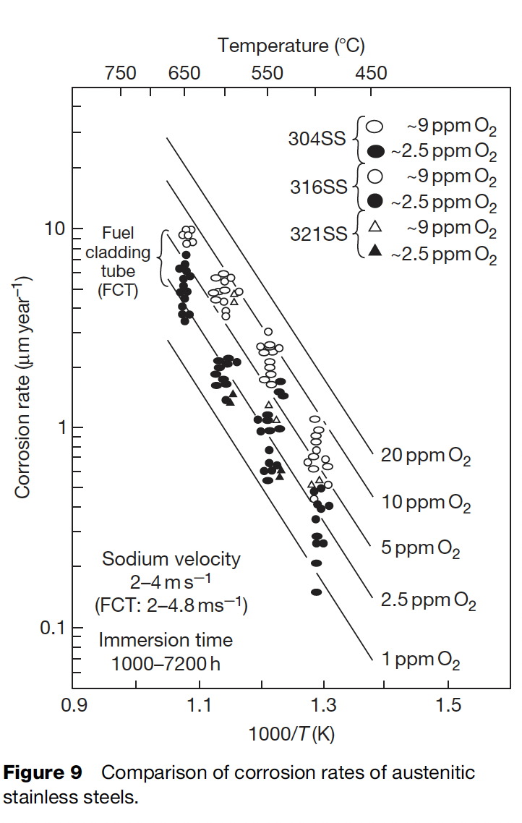
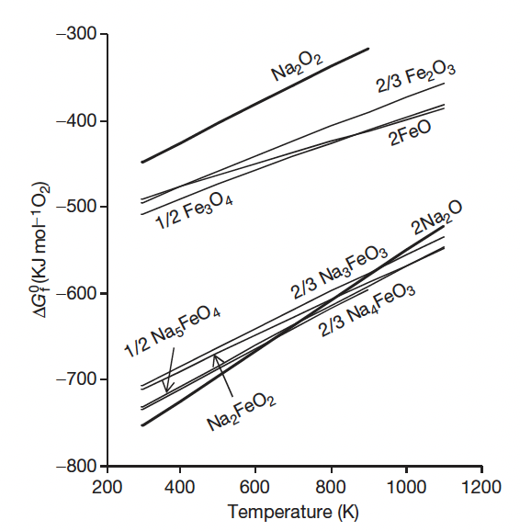


Oxygen Acceleration
The introduction of oxygen into sodium may occur during refueling, supplementing of the reactor cover gas, opening of the coolant boundary for maintenance operations, etc.
The thermodynamically stable oxide in sodium is sodium oxide, Na2O
Fe spontaneously reacts with Na2O above 380C, forming Na4FeO3
These reactions increase the effective solubility of Cr/Fe in Na

Slide 34
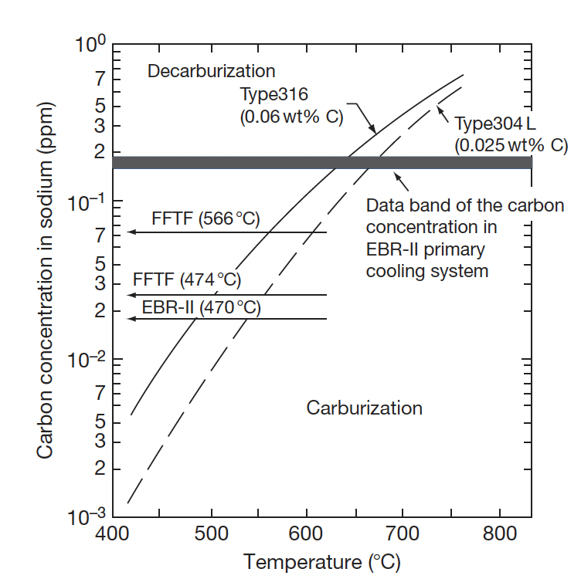
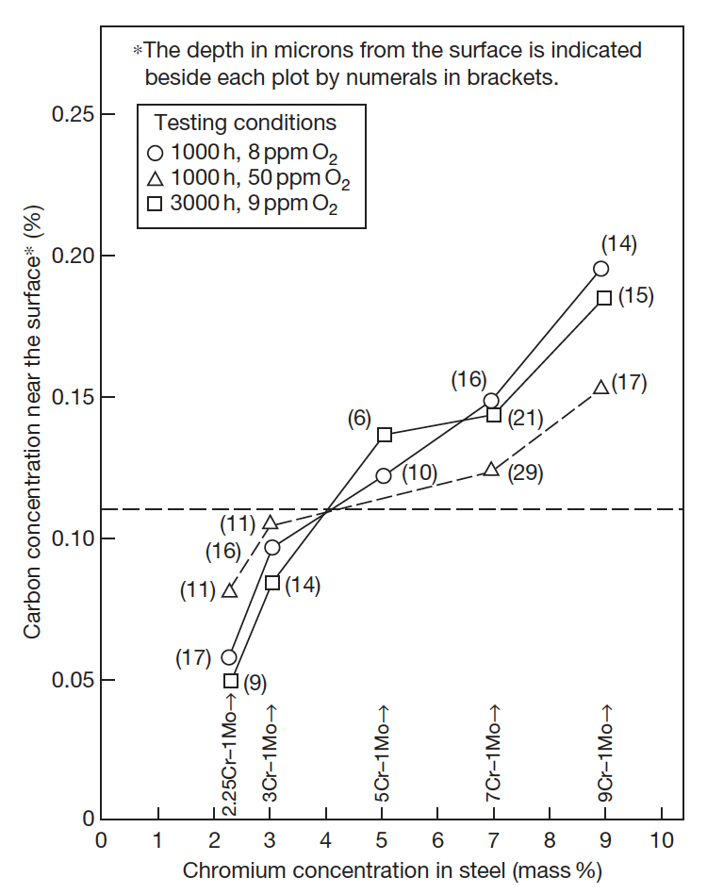
Carbon Effects
Carbon is an important element in maintaining the superior mechanical strength of steel
Carbon transfer can occur due to the chemical activity difference resulting from the temperature gradient
The materials located in the high temperature regions tend to decarburize
If a system has both austenitic and ferritic steels, carbon transfer can occur due to different chemical activities in these materials; austenitic steels carburize
High Cr content reduces susceptibility for decarburization, largely through forming Cr-C precipitates

Slide 35
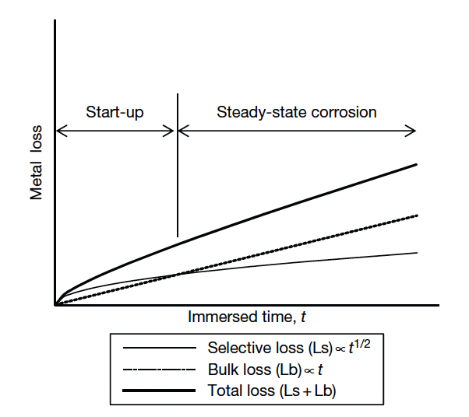
Na Corrosion of Austenitic Steel
The important factors which influence the corrosion of the steels in sodium are: (1) immersion time, (2) temperature, (3) dissolved oxygen, (4) sodium velocity, (5) alloy elements, and (6) carburization and decarburization
Ni and Mn have high Na solubilities and dissolve first in selective (start-up) corrosion, whereas Fe corrodes in general (steady-state) corrosion

Slide 36
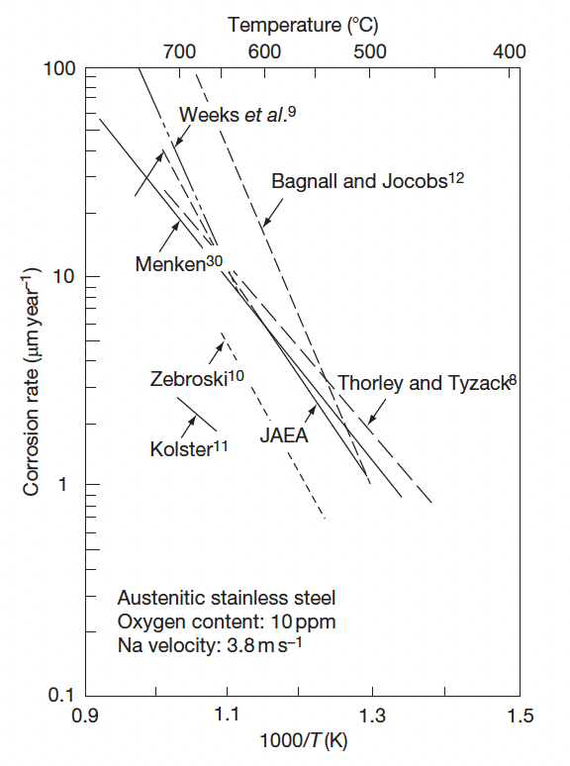
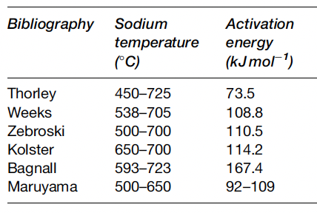
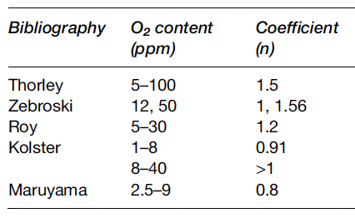
Na Corrosion of Austenitic Steel
Corrosion rate follows an Arrhenius function
The effective activation energy is a function of temperature, and agrees with the activation energy of solubility in Na
This matches the understanding of corrosion through dissolution processes
The corrosion rate is proportional to the oxygen concentration to a power n~1
Thus, limiting O2 in the Na can limit corrosion
Corrosion rates increase with velocity up to a certain point, then become velocity independent

Slide 37
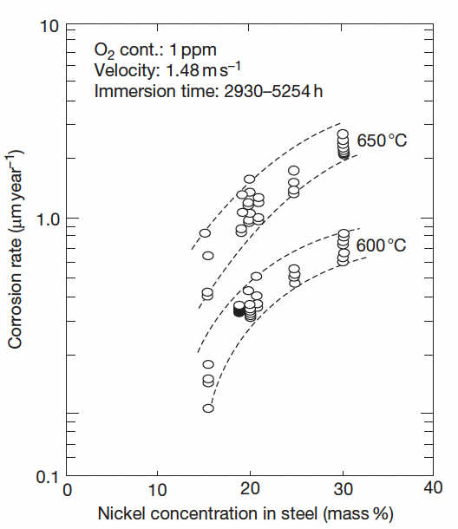
Na Corrosion in Austenitic Steel
Because this is a dissolution driven process, the alloying elements are key to corrosion rates
Ni is especially soluble in Na, and as Ni content increases, corrosion rates increase
Cr has a much low solubility in Na and is thus preferred as an alloying element for Na-facing components
Decarburization or steels can also occur due to the temperature-dependent solubility of C in Na

Slide 38
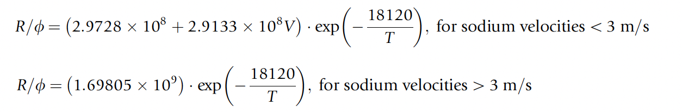
Na Corrosion in Austenitic Steel
Corrosion behavior of austenitic stainless steels is well understood over the temperature range of 455–755 C
It is known that after the initial period of exposure, steady-state corrosion is reached, which governs the long-term corrosion behavior
Have relationships for corrosion which include flow velocity, oxygen content, and temperature

Slide 39
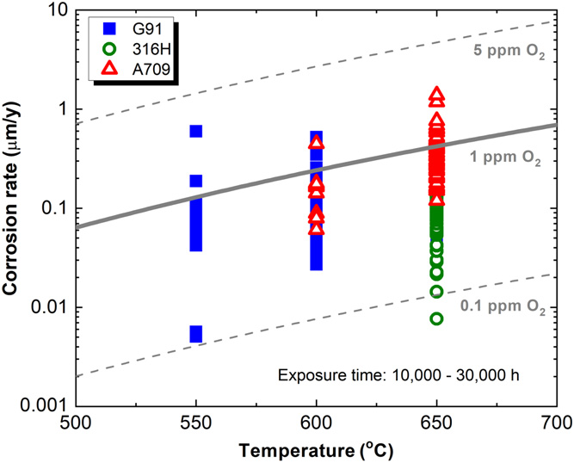
Na Corrosion in Ferritic Steels
Also sensitive to temperature, oxygen content, and Na flow velocity
Low-Cr steels show weight loss and decarburization, while high-Cr steels show weight gain and carburization
Oxygen content tends to increase corrosion rates
Flow velocity effects taper above 7 m/s, higher than in austenitic steels
In general, effects of corrosion in F/M steels are similar to austenitic steels, but with different chemical components

Slide 40
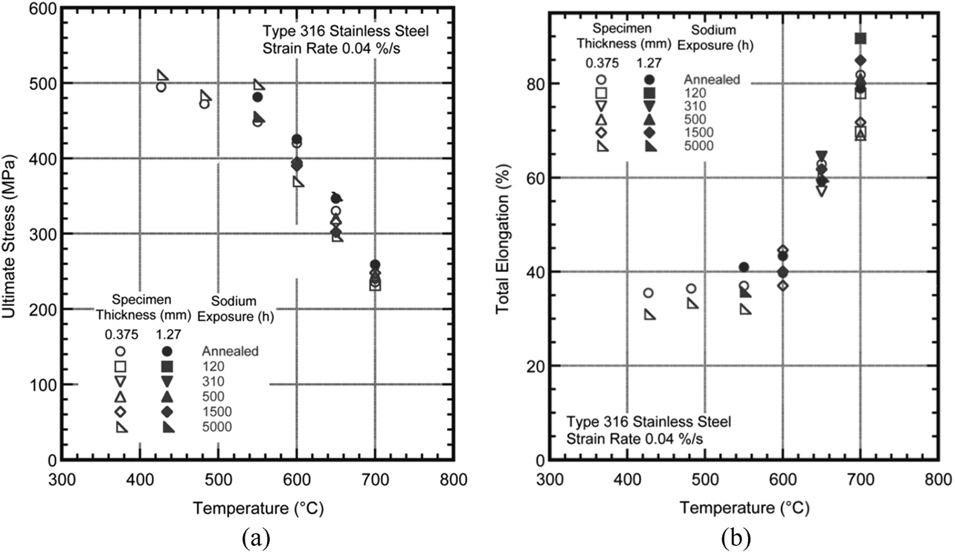
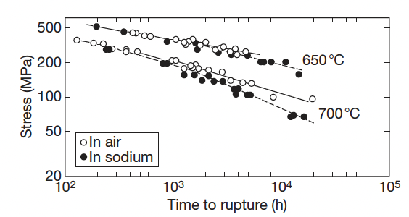
Effects on Mechanical Properties
The effect of sodium on the mechanical strength of steel is determined by three factors: (a) corrosion and mass transfer, (b) decarburization and carburization, and (c) oxidation/reduction
Since the cladding tubes are thin components and are exposed to high temperatures, the sodium corrosion affecting the base metal is larger than that of the structural materials
Minor impacts on tensile strength, elongation, and creep strength for Na vs air
Slight improvement in creep fatigue in sodium compared to air
Creep Strength

Slide 41
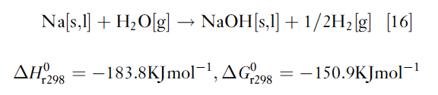
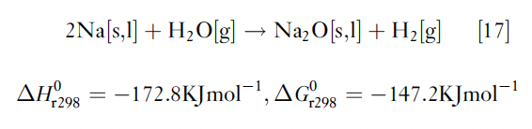
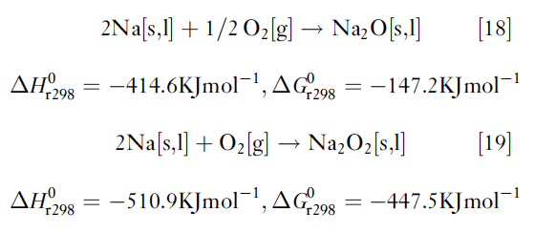
Na-Water/Air Reactions
One of the weak points of the present SFRs is the steam generator
If the steam generator tube is damaged, high-temperature pressurized steam is blown into the sodium
The environment around the failed tube is heated to high temperature (potentially up to 1200C) due to exothermic reactions
When high-temperature sodium is leaked into the atmosphere, it reacts with oxygen, and sodium oxides are formed

Slide 42
Summary
Na is used as a coolant due to high thermal conductivity, high heat capacity, high margin to boiling
There are two known mechanisms of sodium corrosion: Type I: corrosion produced by the dissolution of alloy elements to sodium; Type II: corrosion produced through chemical reaction with the impurities in sodium
Temperature gradient mass transfer is of high concern, based upon solubilities of steel elements, and highly impacts Ni
(De)carburization can occur, but can be limited with high Cr content
Oxygen accelerates corrosion by increasing effective solubilities
Sodium modified the microstructure of steels through precipitation, coarsening, etc.
Mechanical properties are minimally impacted by Na exposure

